Slide 1

Customer Segmentation with RFM and Market Basket Analysis
Group: 3
Debaarati Mitra
Padma Priya Jayaraj
Saniya Amna Khan
Saravanan Jayakumar
Soumya Sinha

Slide 2
Project Steps
01
Problem Statement
Dataset Description
02
03
Descriptive Analysis
Data Preprocessing
04
Market Basket Analysis - Association Rules
05
RFM & K Means Clustering
06

Slide 3



Problem Statement
In early 1990s retail marketers were using their experience and instincts, along with surveys and focus groups, to understand their customer and later in early 2000s radio ads, and magazine ads were used with marketing emails to entice shoppers with offers.
The above marketing method were not efficient as it was increasing the Marketing Budget for every retail industry. After 2010s, Data driven segmentation were implemented to target the customers. But still there are many Statistical method which can be implemented together to improve the efficiency of segmentation.
The union of purchasing data, demographics and location data with RFM, K-means and Market basket Analysis helps retailers to break down large customer profiles into much smaller segments and to identify the purchasing pattern between the items.

Slide 4

Objective
Objective of this project is to combine the purchasing data, demographics and location data with RFM, K-means and Market basket Analysis to help retailers to break down large customer profiles into much smaller segments and to gain insights into granular behavior of customers and also to identify the purchasing pattern between the items.
To significantly improve the marketing performance, making campaigns more relevant to more of customers, to increasing response rates and sales.

Slide 5

Data Description
The Dataset used in the analysis is the Online Retail transnational data which contains all the transactions occurring between 01/12/2010 and 09/12/2011 for a UK-based and registered non-store online retail.
The company mainly sells unique all-occasion gifts. Many customers of the company are wholesalers.
Source:https://archive.ics.uci.edu/ml/machine-learning-databases/00352/

Slide 6
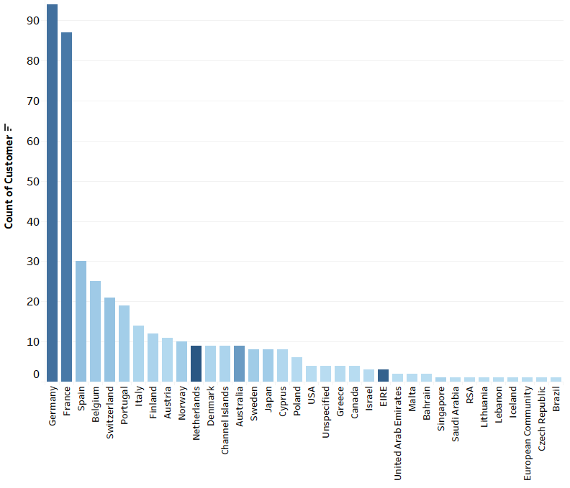
Descriptive Analysis
Since the Dataset, we used is UK based retail company. So all the Transactions are happening in UK. It comprises of 90.46% of data.
In order to interpret the hidden insights from EDA, UK is removed to perform Descriptive Analysis.
From the graph, it is very clear that Germany, France are having higher count of customers after UK.
It is interesting to note that Netherland, Australia and EIRE (Ireland) have low count of customers but with higher amount of Transactions followed by Germany and France.

Slide 7
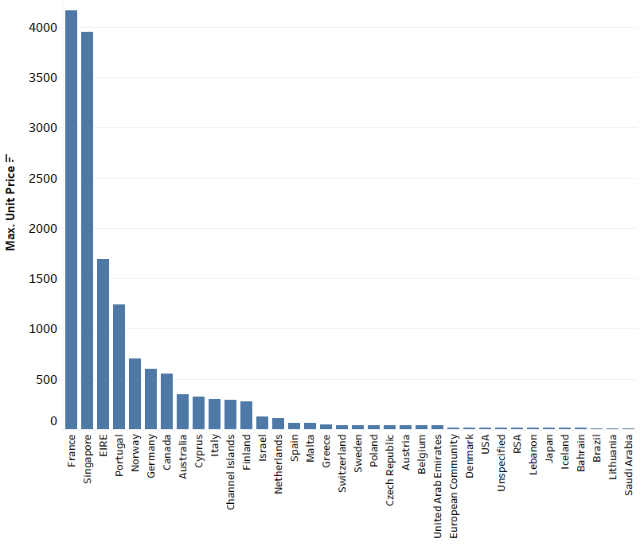
Descriptive Analysis Contd..
From the Graph again, it is found that EIRE(Ireland) and Australia are having Transaction details which are of higher unit values. It is the reason why EIRE and Australia were showing high amount of Transaction even though the number of customers are less.
It is understood that Customers from Australia and EIRE are Wholesale buyers

Slide 8
Data pre-processing
The dataset consists of 541909 rows and 8 variables (Invoice No, Stock Code, Description, Quantity, Invoice Date, Unit Price, Customer ID, Country)
The dataset is read using Pandas, and summary of data is observed for analysis
On observing the summary we find the minimum values of Quantity and Unit Price are in negative which means there is some return transactions in our data
On checking further for few more conditions like:
Quantity < 0 & Unit Price < 0 Returns 0 rows
Quantity < 0 | Unit Price == 0 Returns 1336 rows
Quantity == 0 | Unit Price < 0 Returns 0 rows

Slide 9
Data pre-processing contd..
On analyzing the 1336 rows from the previous step where
Quantity <0 and Unit Price ==0, we find that those rows have Null value for Customer ID column
Our goal is to perform Customer Segmentation and Market Basket Analysis for which Customer ID is very important, so we can disregard all the rows containing Missing values for Customer ID
The dataset is further cleaned by removing the spelling mistakes in Descriptions and multiple descriptions for one of those items to improve the data quality
Now we have a cleaned dataset with 397880 rows and 9 variables

Slide 10

Market Basket Analysis

Slide 11
Association Rule Mining
Rule-based ML method for discerning relations between categorical variables in large transactional databases.
Focused on finding frequent co-occurring associations among a collection of items [antecedent (if) and a consequent (then)] using some measures of interestingness.
Used Apriori algorithm for finding frequent item sets.
Apriori uses a "bottom up" approach, where frequent subsets are extended one item at a time and groups of candidates are tested against the data.
The algorithm terminates when no further successful extensions are found.
Sources: Wikipedia, blog.usejournal.com

Slide 12



Metrics for finding frequent item sets
Support: Indicates how frequently the item pairs appear in data.
Confidence: Gives the number of times the if-then statements are found true.
Lift: States how likely item Y is purchased when item X is purchased, while controlling how popular item Y is. Lift >1 suggests {X} leads to {Y} on the cart.

Slide 13
Process:
Found top 3 countries in the dataset where items are sold most – United Kingdom, Germany, France.
Formatted data by grouping together items by invoice numbers for each of the three countries.
Used the mlxtend library’s apriori function to find frequent item sets and association_rules to formulate top 5 rules for each country.
Plotted the top 5 rules in a graph format using networkx library.
Country | Invoice No
United Kingdom | 354317
Germany | 9040
France | 8341

Slide 14
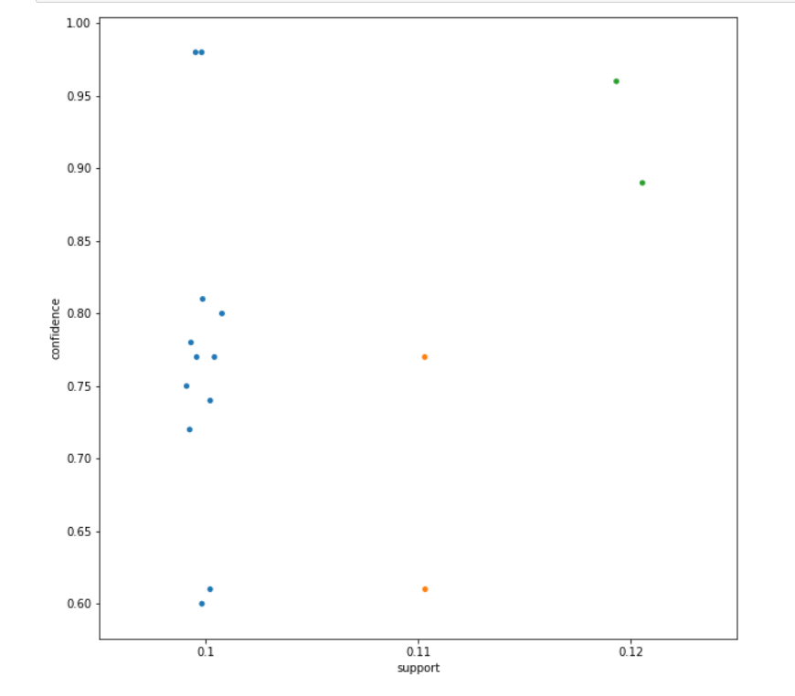
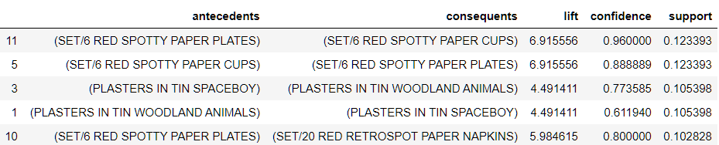
France Used Support cutoff value of 10%, confident 70% and lift cutoff of 1.
Support vs Confidence
Top 5 rules:
In the next slide, red node denotes rule, green slides denote antecedent and consequents.
Graph shows the relation as:
Antecedent -> Rule->Consequents
More the value of lift, greater are the chances of preference to buy consequent if the customer has already bought antecedent.

Slide 15
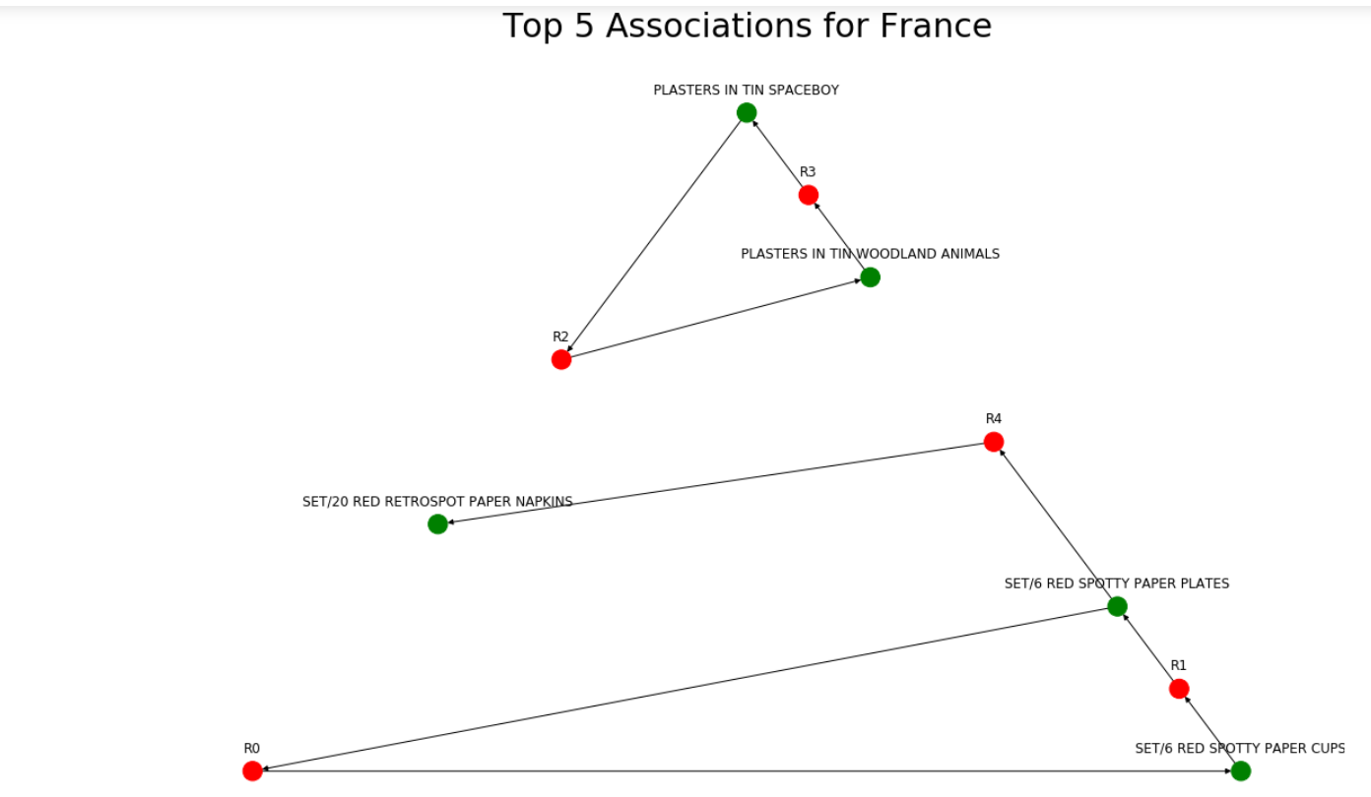

Slide 16
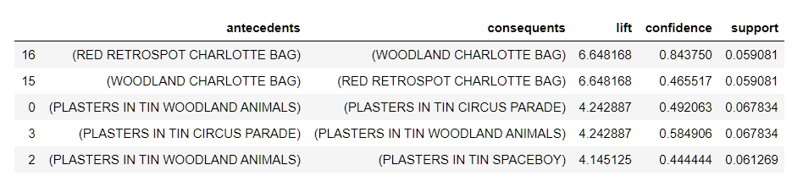
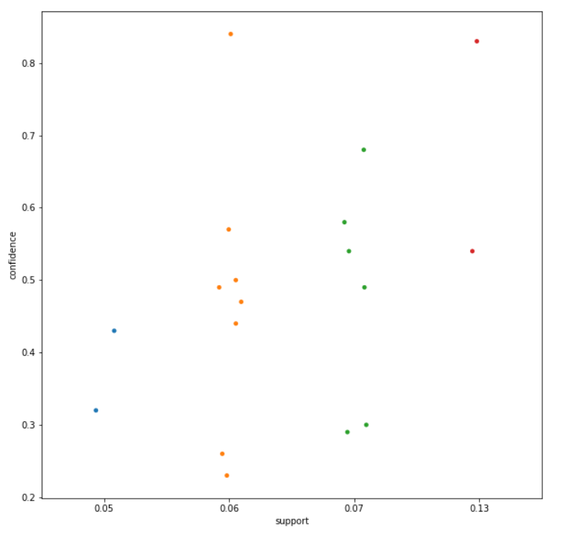
Germany Used support cutoff as 5%, lift values>4
Support vs Confidence
Top 5 rules for Germany:
Had to choose a lower support to get top 5 rule, suggesting items in Germany purchased are more diverse.

Slide 17
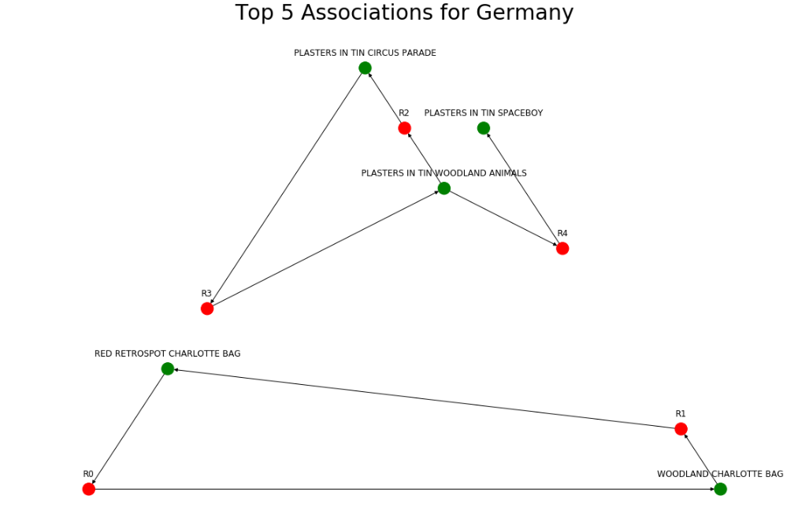

Slide 18
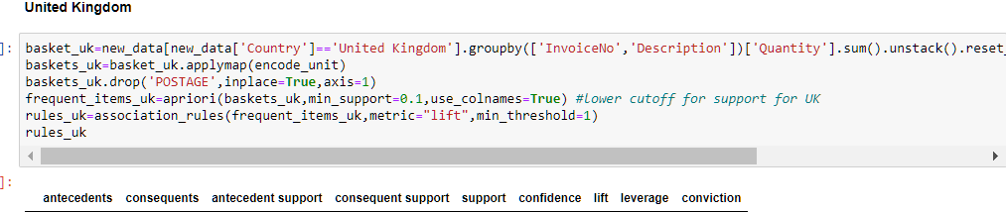
United Kingdom
For UK, there were no items which had a lift > 1 even for marginal values of support. Hence no significant associations found.

Slide 19

Customer Segmentation

Slide 20
Customer Segmentation
Two types of customer segmentation methods:
RFM segmentation
K means clustering
RFM stands for Recency, Frequency and Monetary value. It used the past purchase behaviour of customer for segmentation
Recency: # of days since last purchase being made
Frequency: # of total purchases being made
Monetary: Total amount spent by the customers in purchasing

Slide 21
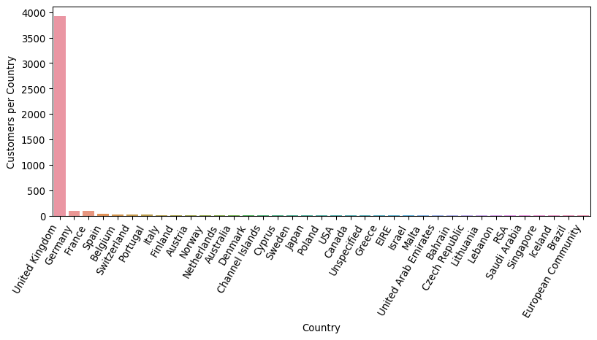
Customer Segmentation using RFM
UK has the highest number of customers so RFM was performed on UK alone

Slide 22
Identifying segmented customers for targeting
After creating these 3 metrics best customers were analysed.
Customers that have the lowest recency, highest frequency and monetary value are the top customers.
Customers that have the lowest recency, lowest frequency and monetary value are the churning customers.
Total Customers in UK: 3920
Frequent Regular High Purchase Customers: 409
Loyal Customers with High Frequency: 980
Hefty Spend Customers: 980
Churning Customers: 343

Slide 23
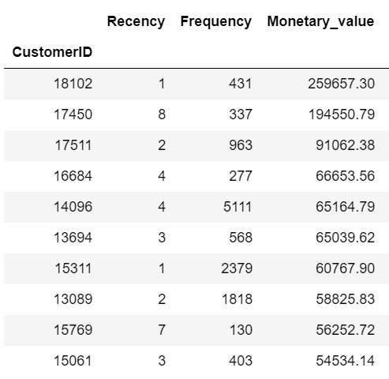
Identification of Top customers-based on Spend
Shows the top 10 customers based on the spend/monetary value.
This is one of the ways to analyse customer segments
Next we will see another method where we will be using K-means for customer segmentation

Slide 24
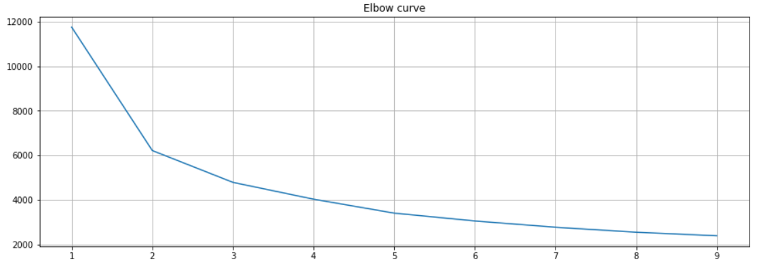
Customer Segmentation using K means
For k-means, we must set k to the number of clusters we want to use.
On plotting the elbow curve for scaled values of the recency , frequency and monetory_value, we see that point 6 onwards the curve starts to flatten, so we decide onto making 6 clusters.

Slide 25
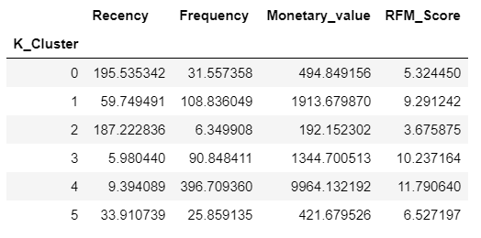
Interpreting The Cluster Values
Cluster 0:
In the past 195 days, the frequency of these customers is 31 days which resulted a monetary output of 495.
Cluster 1:
Similarly, in past 60 days, customers of cluster 1 visited 108 times which is a high value hence we can expect a high monetary output which is true in this case since the value is 1914.
Cluster 2:
Customers who visited in the past 187 days, had a frequency of 6 days which had a monetary value of 192. Since the number of transactions is the least for this cluster, the RFM score is the least for this scenario.

Slide 26
Interpreting The Cluster Values
Cluster 3:
Customers in the cluster 3 visited the outlet 90 times in total in the past 6 days which created a monetary value of 1345. Since the monetary value is high , hence the customer engagement score i.e. RFM score is the high : 10.
Cluster 4:
Customers who visited in the past 9 days had a frequency of 397 times i.e. the number of transactions resulting to a transaction value of 9964. The RFM score is the highest for this cluster since the monetary value and the frequency of transaction is the highest.
Cluster 5:
The customers who made a transaction in the past 33 days, resulted in 26 transactions with a total monetary value of 421.

Slide 27
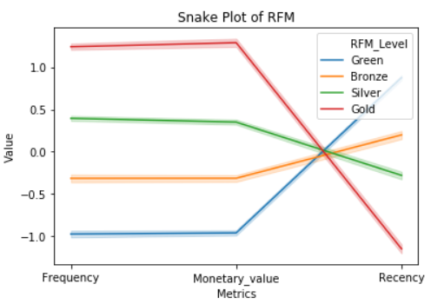
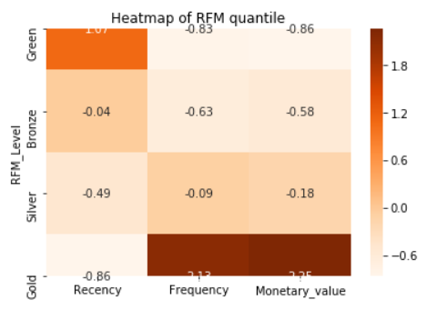
Plotting quartiles
On summing up the values of the RFM score for Recency, Frequency and Monetary value for each customer, we categorize them into 4 categories :
‘Gold,’ ‘Silver,’ ‘Bronze,’ and ‘Green’

Slide 28
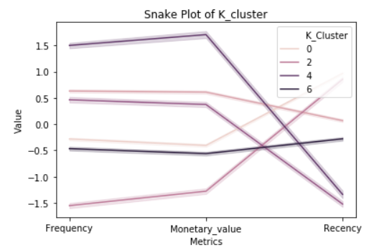
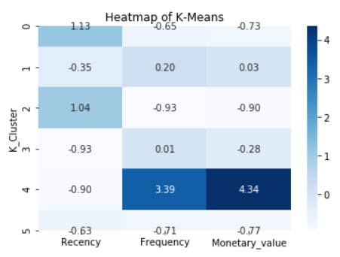
Plotting Clusters
On melting the scaled RFM values into one column for each cluster from which we plot the average values received for each cluster for Recency, Frequency and Monetary value.

Slide 29

Thank You

